Slide 1

Communication-aware Job Scheduling using SLURM
Priya Mishra, Tushar Agrawal, Preeti Malakar
Indian Institute of Technology Kanpur
16th International Workshop on Scheduling and Resource Management for Parallel and Distributed Systems

Slide 2
Introduction
ICPP – SRMPDS’20 Communication-aware Job Scheduling using SLURM
Job Scheduling deals with cluster management and resource allocation as per job requirements
Users submit jobs specifying nodes and wall-clock time required
Current job schedulers do not consider job-specific characteristics or communication-patterns of a job
May lead to interference from other communication-intensive jobs
Placing frequently communicating node-pairs several hops away leads to high communication times
Notes:
Job scheduling is an important area of research that deals with cluster management and resource allocation as per job requirements. These job requirements are usually specified in terms of the number of nodes and the wall-clock time required for the execution of the job. Most job schedulers allocate nodes without considering the job characteristics, such as whether a job is communication-intensive or compute-intensive or I/O-intensive. Further, most current resource managers do not consider the communication patterns of a communication-intensive job while allocating nodes. This may lead to interference from other communication-intensive jobs, which may share the same network links and or switches for communications at the same time. Additionally, placing frequently communicating node-pairs several hops away often leads to high communication times due to network congestion and long-hop communications.

Slide 3
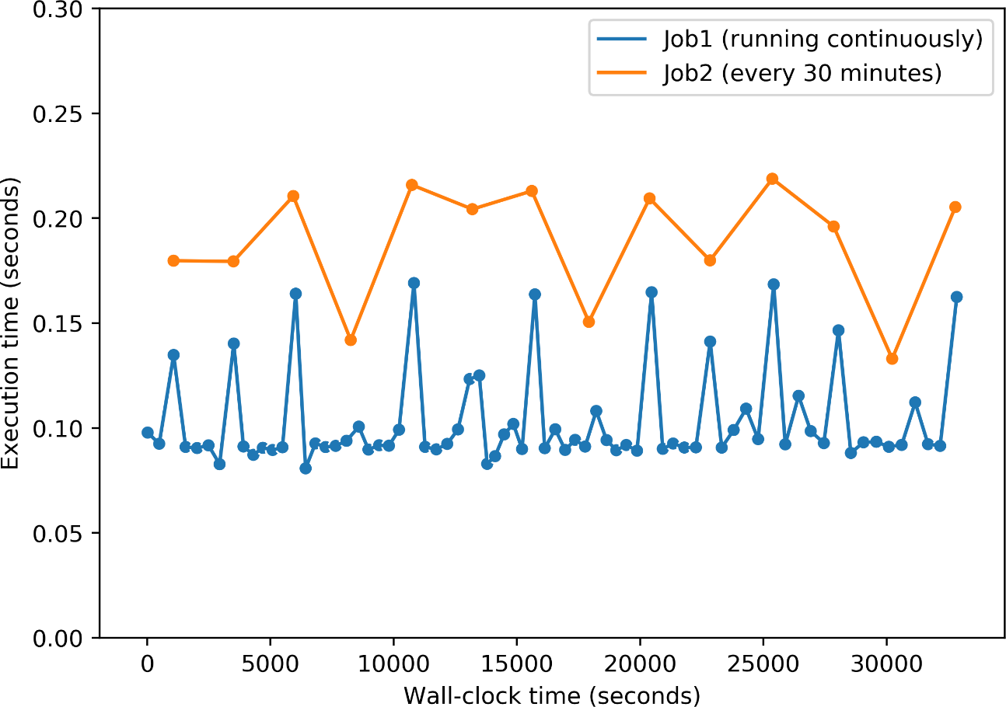
Effect of network contention
ICPP – SRMPDS’20 Communication-aware Job Scheduling using SLURM
J1 and J2 are two parallel MPI¹ jobs
J1 executed repeatedly on 8 nodes (4 nodes on 2 switches)
J2 executed every 30 minutes on 12 nodes spread across same two switches
Sharp increase in execution time of J1 when J2 is executed
Sharing switches/links degrades performance
Notes:
To study the effect of contention caused due to sharing of switches or links on the execution time of communication-intensive jobs, we conducted an experiment on our department cluster. We execute two parallel MPI jobs, J1 and J2, spread across two switches that are connected in tree-like topology. These jobs execute MPI_Allgather collective communication using large message size(1 MB). The first job J1 is executed repeatedly on 8 nodes during this experiment. The second job J2, is executed every 30 minutes on 12 nodes spread across the same two switches. Hence, the two jobs share switches. Their effect on each other’s execution time is shown in the Figure, where the blue curve shows J1, and the orange curve shows J2. The execution time is shown along the y-axis and the wall-clock time along the x-axis. We observed a sharp increase in the execution time of J1 whenever J2 was executed (seen as spikes in the blue curve). This occurred when the two jobs ran simultaneously and thus communicated simultaneously over shared switches/links. This shows that it is important to carefully select nodes to avoid performance degradation.

Slide 4
ICPP – SRMPDS’20 Communication-aware Job Scheduling using SLURM
OBJECTIVE
Developing node-allocation algorithms that consider the job’s behaviour during resource allocation to improve the performance of communication-intensive jobs

Slide 5
Network Topology
ICPP – SRMPDS’20 Communication-aware Job Scheduling using SLURM
We use fat-tree¹ based network topology in our study
s2
Level 2 switch
s0
s1
Leaf switch
n0
n1
n2
n3
n4
n5
n6
n7
Nodes
¹ C. E. Leiserson. 1985. Fat-trees: Universal networks for hardware-efficient super-computing. IEEE Trans. Comput.10 (1985), 892–901.
.
Notes:
In our work, we consider fat-tree based network topology for the implementation and evaluation of our algorithms. An example of a two-level fat-tree topology is shown in Figure 2. The level 1 switches, also known as leaf switches (𝑠0 and 𝑠1), are connected to the compute nodes (𝑛0 − 𝑛7). Each compute node is connected to only one leaf switch. The level 2 switches (𝑠2) may be connected to one or more level 1 switches.

Slide 6
SLURM – Simple Linux Utility for Resource Management¹
ICPP – SRMPDS’20 Communication-aware Job Scheduling using SLURM
Select/linear plugin allocates entire nodes to jobs
Supports tree/fat-tree network topology via topology/tree plugin
Default SLURM algorithm uses best-fit allocation
s2
s0
s1
n0
n1
n2
n3
n4
n5
n6
n7
¹ Andy B. Yoo, Morris A. Jette, and Mark Grondona. 2003. SLURM: Simple Linux Utility for Resource Management. In Job Scheduling Strategies for Parallel Processing.
.
Notes:
In this study, we have used SLURM which is a widely-used, open source resource management and job scheduling system . The SLURM architecture uses multiple plugins for different tasks. The scheduler plugin selects the type of scheduler to use. SLURM uses a First-In-First-Out scheduling policy with backfilling. The select/linear plugin is used for allocating entire nodes to the jobs. In our study, we propose new node allocation algorithms using this plugin. SLURM supports resource allocations for clusters with tree and fat-tree network topologies via the topology/tree plugin. The default node allocation algorithm identifies the lowest level switch that has the requested number of nodes available. For example., assume that nodes 𝑛0 and 𝑛1 are already allocated in the fat-tree network shown in Figure 2. Now if a job requires 4 nodes, the lowest level switch would be 𝑠1, whereas if a job requires 6 nodes, the lowest level switch would be 𝑠2. The algorithm first allocates nodes on those leaf switches that have minimum number of nodes available. This is known as best-fit allocation, typically used to reduce resource fragmentation.

Slide 7
Communication Patterns
ICPP – SRMPDS’20 Communication-aware Job Scheduling using SLURM
We assume that submitted parallel jobs use MPI for communication
Global communication matrix
May not reflect most crucial communications
Temporal communication information is not considered
We consider the underlying algorithms of MPI collectives
We consider three standard communication patterns – recursive doubling (RD), recursive halving with vector doubling (RHVD) and binomial tree algorithm

Slide 8
Communication Patterns
ICPP – SRMPDS’20 Communication-aware Job Scheduling using SLURM
Gives a more definitive communication pattern without incurring profiling cost
Important for applications where the collective communication costs dominate the execution times
Our strategies consider all stages of algorithms (RD, RHVD, Binomial) and allocate based on the costliest communication step/stage
Difficult to achieve using a communication matrix

Slide 9
Communication-aware Scheduler
ICPP – SRMPDS’20 Communication-aware Job Scheduling using SLURM
We propose mainly two node-allocation algorithms – greedy, balanced
Every job is categorized as compute or communication intensive
Can be deduced using MPI profiles of MPI application¹ or through user input
Algorithms identify lowest-level common switch with requested number of nodes available
If this lowest-level switch is leaf-switch → requested number of nodes allocated to the job
Notes:
Greedy aims to allocate nodes such that there is minimum contention
Balanced also considers communication pattern to minimize inter-switch communication

Slide 10
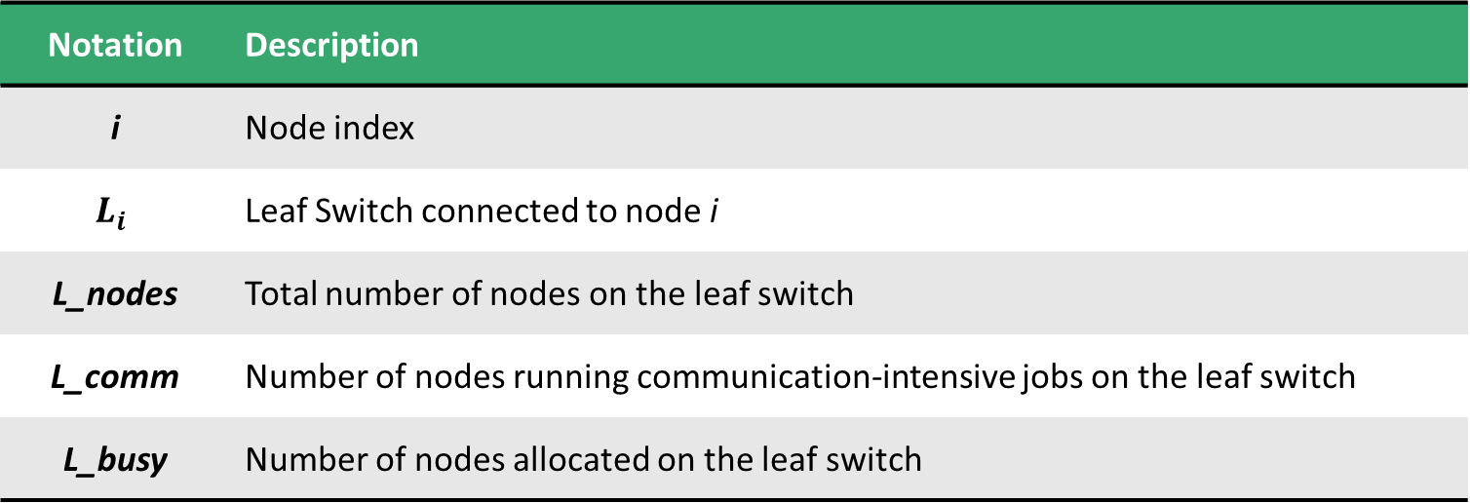
Common Notations
ICPP – SRMPDS’20 Communication-aware Job Scheduling using SLURM
Notation | Description
i | Node index
$$L_{i}$$ | Leaf Switch connected to node i
L_nodes | Total number of nodes on the leaf switch
L_comm | Number of nodes running communication-intensive jobs on the leaf switch
L_busy | Number of nodes allocated on the leaf switch

Slide 11
Greedy Allocation
ICPP – SRMPDS’20 Communication-aware Job Scheduling using SLURM
Minimize network contention by minimizing link/switch sharing
For communication-intensive job select the leaf switches which:
Have maximum number of free nodes
Minimum number of running communication-intensive jobs

Slide 12

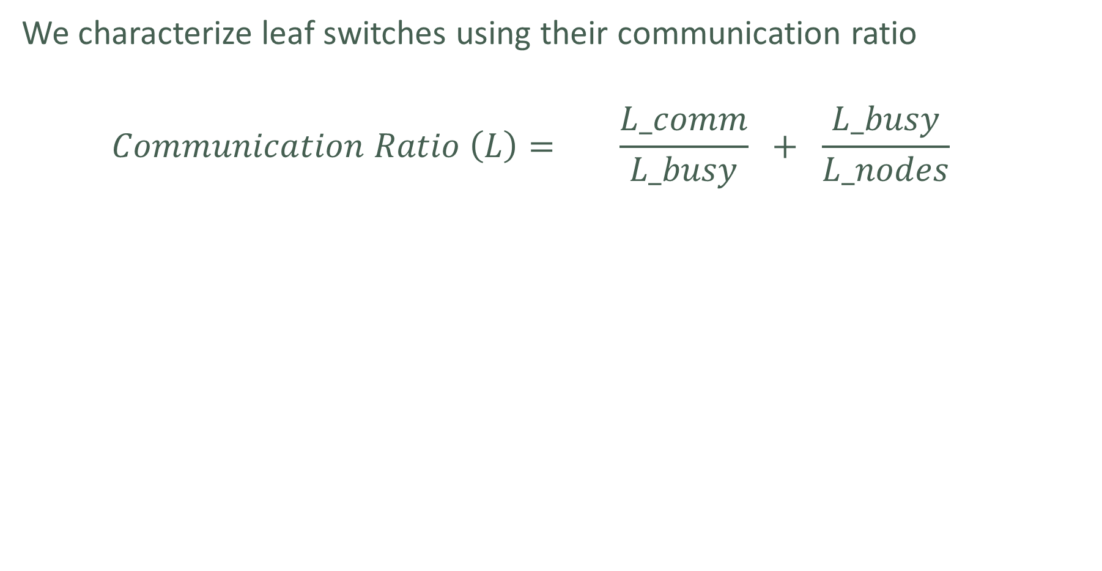
ICPP – SRMPDS’20 Communication-aware Job Scheduling using SLURM
We characterize leaf switches using their communication ratio
$$\begin{aligned}Communication Ratio \left(L\right)= \frac{L_comm}{L_busy} + \frac{L_busy}{L_nodes} \end{aligned}$$
Number of communication-intensive jobs relative to the busy nodes on leaf switch
Measure of available nodes on leaf switch
Measure of contention
Controls node-spread
Lower communication-ratio → lower contention and higher number of free nodes

Slide 13
Design of Greedy Allocation
ICPP – SRMPDS’20 Communication-aware Job Scheduling using SLURM
Sort underlying leaf switches in order of communication ration
Communication-intensive
Compute-intensive
Switches sorted in increasing order
Switches sorted in decreasing order
Requested number of nodes allocated from switches in sorted order

Slide 14
Balanced Allocation
ICPP – SRMPDS’20 Communication-aware Job Scheduling using SLURM
Aims at allocating nodes in powers of two to minimize inter-switch communication
STEP 1
STEP 1
STEP 2
STEP 2
STEP 3
STEP 3
Unbalanced Allocation
Balanced Allocation

Slide 15
Design of Balanced Allocation
ICPP – SRMPDS’20 Communication-aware Job Scheduling using SLURM
Sort underlying leaf switches in order of free nodes
Communication-intensive
Compute-intensive
Switches sorted in decreasing order
Switches sorted in increasing order
Leaf switches traversed in sorted order and number of nodes allocated on each is the largest power of two that can be accommodated
Requested number of nodes allocated from switches in sorted order
Remaining Nodes > 0 ?
Remaining free nodes on each leaf switch are allocated by traversing them in reverse sorted order

Slide 16
Consider a job that requires 512 nodes
ICPP – SRMPDS’20 Communication-aware Job Scheduling using SLURM
Leaf Switch
L[1]
L[2]
L[3]
L[4]
L[5]
L[6]
L[7]
Free Nodes
160
150
100
80
70
50
40
Allocated Nodes
128
128
64
64
64
32
32
512
256
128
128
256
128
128
64
64
64
64
32
32

Slide 17
Adaptive Allocation
ICPP – SRMPDS’20 Communication-aware Job Scheduling using SLURM
Greedy allocation minimizes contention and fragmentation
Unbalanced, more inter-switch communication
Balanced allocation minimizes inter-switch communication
More fragmentation
Adaptive allocation compares both allocations and selects the more optimal node allocation based on their cost of communication
Notes:
However, the allocation is unbalanced and may have inter-switch communication than the optimal case
However, allocating in powers of two may lead to more fragmentation that can outweigh the benefit of decreased inter-switch communication
For communication-intensive job it selects the one with lower cost
For compute-intensive job it selects the one with higher cost

Slide 18
Experimental Setup
ICPP – SRMPDS’20 Communication-aware Job Scheduling using SLURM
We evaluate using job logs of Intrepid, Theta and Mira¹ supercomputers
Intrepid logs from Parallel Workload Archive²
Theta and Mira logs from Argonne Leadership Computing Facility³
Contain job name, nodes requested, submission times, start times etc.
1000 jobs from each log
¹ 2020. Mira and Theta. https://www.alcf.anl.gov/alcf-resources
² 2005. Parallel Workload Archive. www.cse.huji.ac.il/labs/parallel/workload/
³ 2019. ALCF, ANL. https://reports.alcf.anl.gov/data/index.html
.

Slide 19
Experimental Setup
ICPP – SRMPDS’20 Communication-aware Job Scheduling using SLURM
Do not have any information about nature of the job
Some jobs are assumed communication-intensive, others as compute-intensive
Percentage of communication-intensive jobs varied from 30% - 90%
Jobs with power-of-two node requirements considered
Job logs emulated by configuring SLURM with enable-front-end option
Run for same duration as their execution times

Slide 20
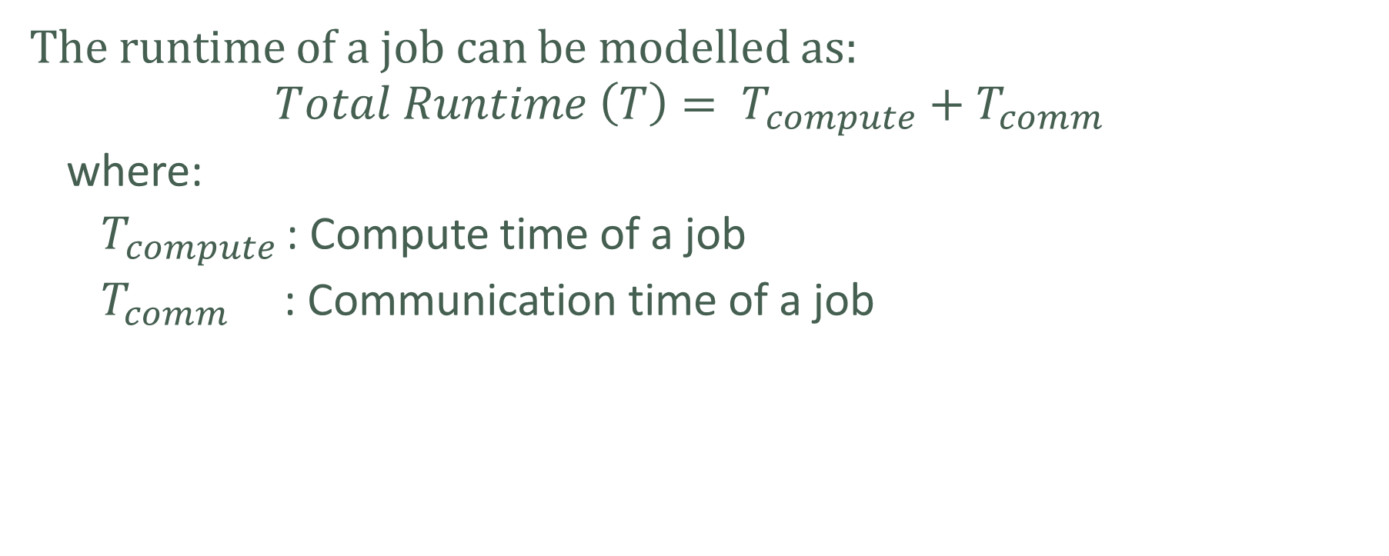
Runtime Estimates
ICPP – SRMPDS’20 Communication-aware Job Scheduling using SLURM
The runtime of a job can be modelled as:
$$Total Runtime \left(T\right)= T_{compute}+T_{comm}$$
where:
$T_{compute }$: Compute time of a job
$T_{comm}$ : Communication time of a job

Slide 21
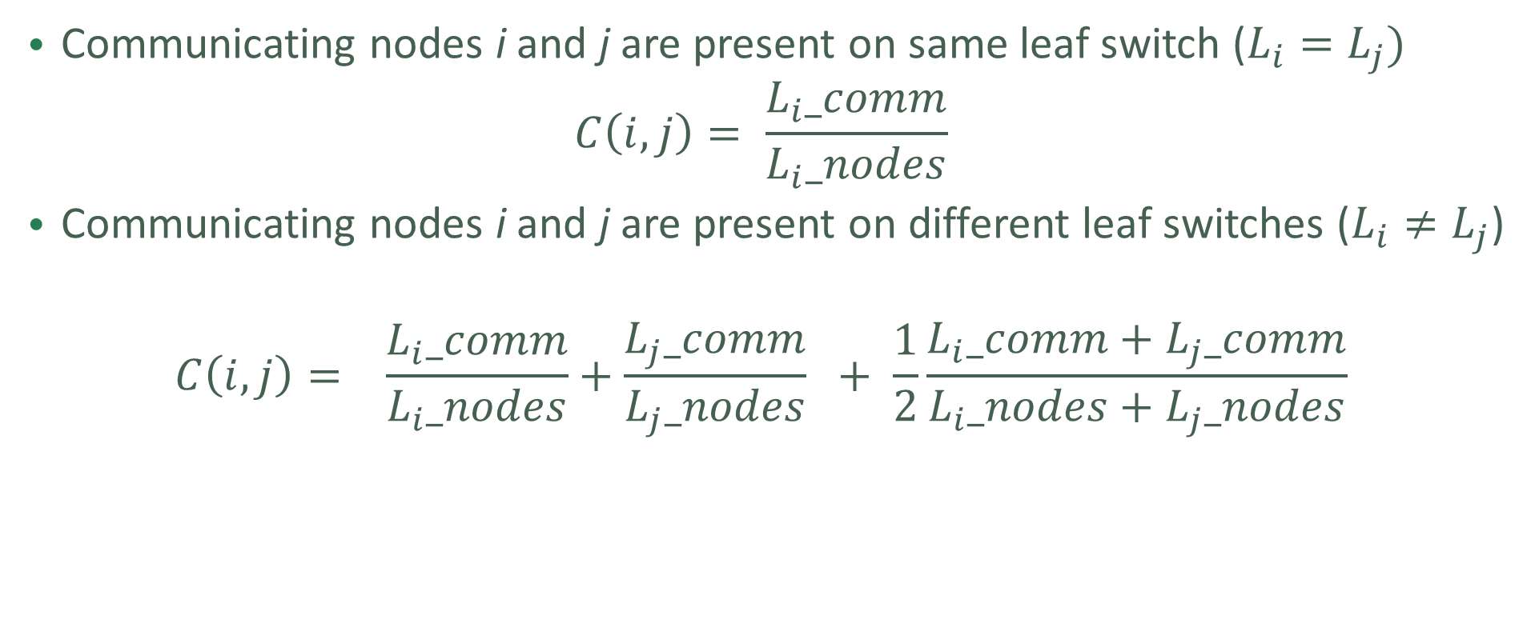
Contention Factor C(i,j)
ICPP – SRMPDS’20 Communication-aware Job Scheduling using SLURM
Communicating nodes i and j are present on same leaf switch ($L_{i}=L_{j})$
$$C\left(i,j\right)= \frac{L_{i}_comm}{L_{i}_nodes}$$
Communicating nodes i and j are present on different leaf switches ($L_{i}≠L_{j}$)
$$C\left(i,j\right)= \frac{L_{i}_comm}{L_{i}_nodes}+\frac{L_{j}_comm}{L_{j}_nodes} + \frac{1}{2}\frac{L_{i}_comm+L_{j}_comm}{L_{i}_nodes+L_{j}_nodes}$$
Contention on individual leaf switches
Contention on lowest-level common switch connecting the two leaf switches

Slide 22
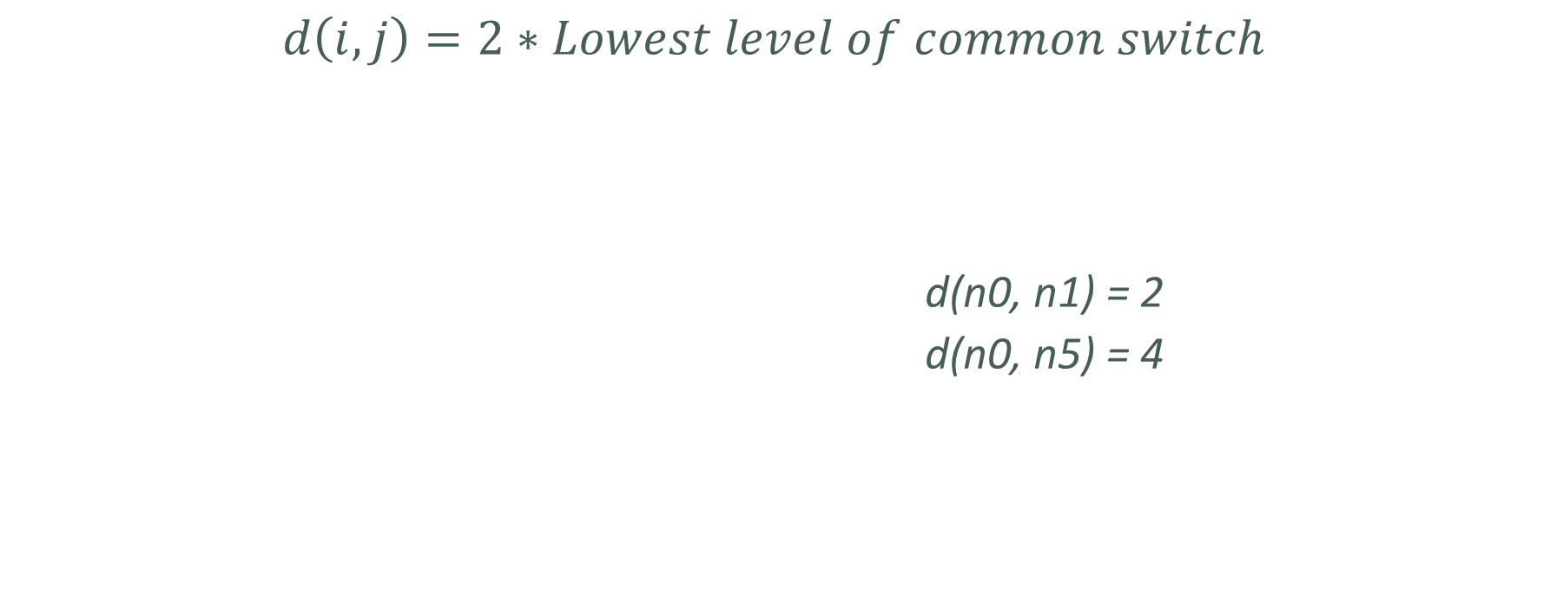
Distance d(i,j)
ICPP – SRMPDS’20 Communication-aware Job Scheduling using SLURM
$$d\left(i,j\right)=2∗Lowest level of common switch$$
d(n0, n1) = 2
d(n0, n5) = 4
s2
s0
s1
n0
n1
n2
n3
n4
n5
n6
n7

Slide 23
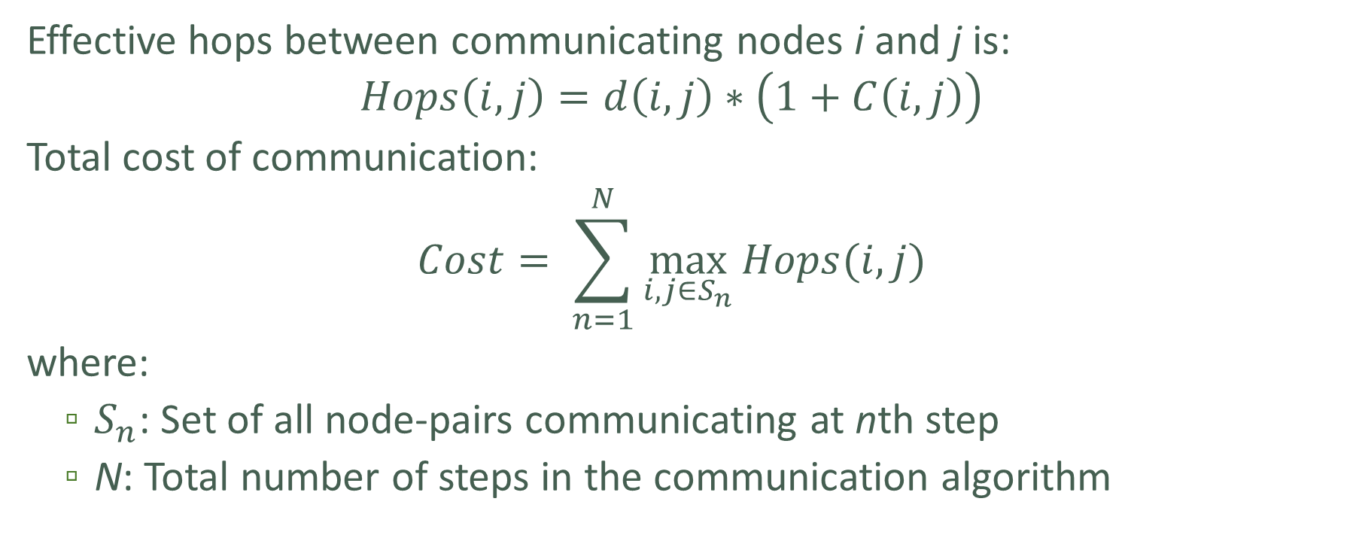
Cost of communication
ICPP – SRMPDS’20 Communication-aware Job Scheduling using SLURM
Effective hops between communicating nodes i and j is:
$$Hops\left(i,j\right)=d\left(i,j\right)∗\left(1+C\left(i,j\right)\right)$$
Total cost of communication:
$$Cost= \sum_{n=1}^{N}{\max_{i,j∈S_{n}}{Hops(i,j)}}$$
where:
$S_{n}$: Set of all node-pairs communicating at nth step
N: Total number of steps in the communication algorithm

Slide 24
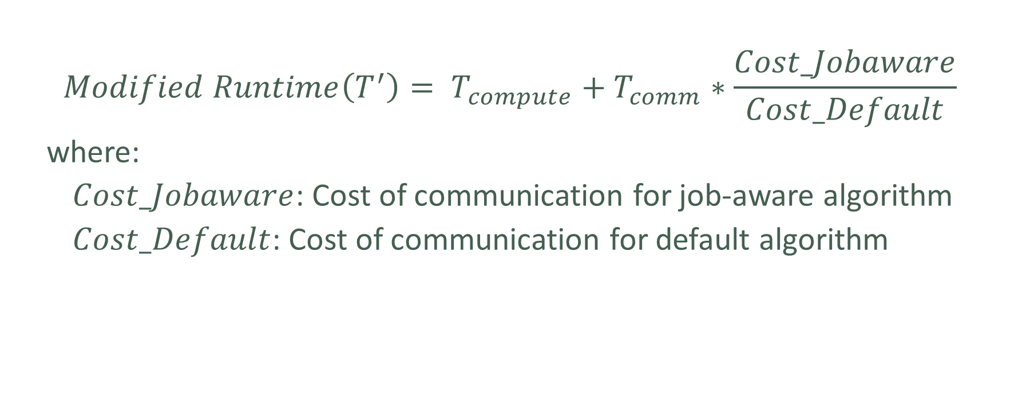
Modified Runtime
ICPP – SRMPDS’20 Communication-aware Job Scheduling using SLURM
$$Modified Runtime\left(T^{′}\right)= T_{compute}+T_{comm}∗\frac{Cost_Jobaware}{Cost_Default}$$
where:
$Cost_Jobaware$: Cost of communication for job-aware algorithm
$Cost_Default$: Cost of communication for default algorithm

Slide 25
Evaluation metrics
ICPP – SRMPDS’20 Communication-aware Job Scheduling using SLURM
Execution time – Time between start and completion of job
Wait time – Time between submission and start of job
Turnaround time – Time between submission and completion of job
Node Hour – Number of nodes * Execution time
Cost of communication

Slide 26
Types of Experiments
ICPP – SRMPDS’20 Communication-aware Job Scheduling using SLURM
Continuous Runs
1000 jobs are run using the submission times derived from logs
Individual Runs
Jobs are submitted one at a time to a partially occupied cluster
Provides common starting point to compare allocation of each job

Slide 27
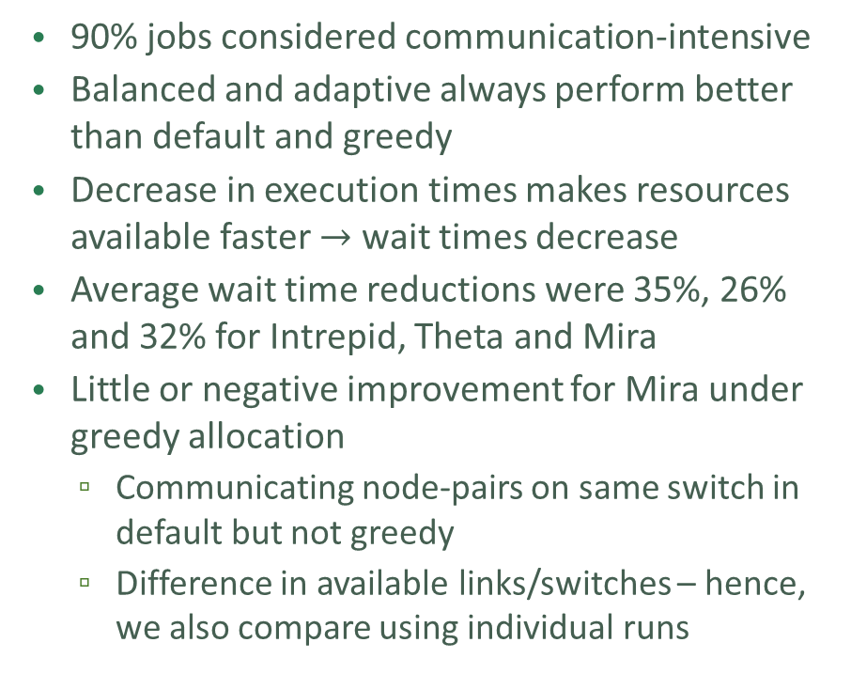
Impact on Execution Time and Wait Time
ICPP – SRMPDS’20 Communication-aware Job Scheduling using SLURM
Job Log | Algorithms | Execution Time (Hours)
 |  | Default | Greedy | Balanced | Adaptive
Intrepid | RHVD | 1382 | 1351 | 1256 | 1251
 | RD |  | 1345 | 1264 | 1257
Theta | RHVD | 2189 | 1740 | 1700 | 1663
 | RD |  | 1810 | 1731 | 1706
Mira | RHVD | 3289 | 3956 | 2342 | 2435
 | RD |  | 3285 | 2559 | 2637
90% jobs considered communication-intensive
Balanced and adaptive always perform better than default and greedy
Decrease in execution times makes resources available faster $→$ wait times decrease
Average wait time reductions were 35%, 26% and 32% for Intrepid, Theta and Mira
Little or negative improvement for Mira under greedy allocation
Communicating node-pairs on same switch in default but not greedy
Difference in available links/switches – hence, we also compare using individual runs
Table: Execution times (in hours) in all three job logs
Average improvement in execution time – 9%
Average improvement in wait time – 31%

Slide 28
Continuous vs Individual Runs
ICPP – SRMPDS’20 Communication-aware Job Scheduling using SLURM
Job Log | Algorithms | Execution Time (% improvement)
 |  | Greedy | Balanced | Adaptive
Intrepid | RHVD | 3.65 | 7.23 | 7.81
 | RD | 1.70 | 8.12 | 8.29
Theta | RHVD | 9.65 | 9.65 | 9.65
 | RD | 13.56 | 13.56 | 13.56
Mira | RHVD | 10.84 | 19.69 | 21.71
 | RD | 9.45 | 24.32 | 24.91
For a given state of cluster, proposed algorithms always perform better than default
2-13% improvement using greedy allocation
7-25% improvement using balanced and adaptive allocation
Similar to continuous, balanced and adaptive perform better than greedy
Table: Improvements in execution times

Slide 29
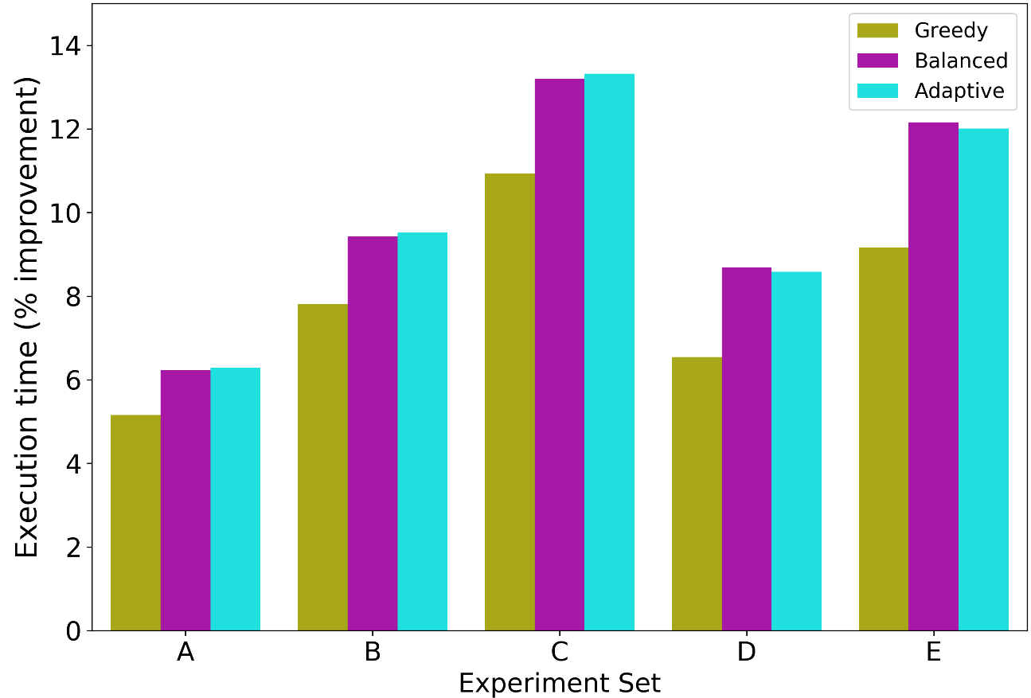
Variation in Communication Patterns
ICPP – SRMPDS’20 Communication-aware Job Scheduling using SLURM
A – 67% compute, 33% RHVD
B – 50% compute, 50% RHVD
C – 30% compute, 70% RHVD
D – 50% compute, 15% RD, 35% Binomial
E – 30% compute, 21% RD, 49% Binomial
For same communication pattern, as communication ratio increases from A (33%) to C (70%), gain increases
Larger fraction of execution time reduces
Similarly between D and E
Figure: Reduction in execution time using various communication patterns for Theta

Slide 30
Conclusion
ICPP – SRMPDS’20 Communication-aware Job Scheduling using SLURM
Proposed three node allocation algorithms to improve performance of communication-intensive jobs
Evaluated algorithms using three supercomputer job logs
Demonstrate that proposed algorithms improve execution times, wait times and system throughput

Slide 31
Future Work
ICPP – SRMPDS’20 Communication-aware Job Scheduling using SLURM
Include other communication patterns
Explore process mapping after node allocation
Extend to other topologies

Slide 32
ICPP – SRMPDS’20 Communication-aware Job Scheduling using SLURM
Thank You!

Slide 33
Communication Patterns
ICPP – SRMPDS’20 Communication-aware Job Scheduling using SLURM
MPI collectives occur more prominently than point-to-point in production supercomputing applications¹
MPI collectives constitute most time-consuming part of application runtimes (FFTW (MPI_Alltoall), OpenFOAM(MPI_Allreduce)) ¹

Slide 34
Acknowledgements
ICPP – SRMPDS’20 Communication-aware Job Scheduling using SLURM
We are thankful to the Computer Center, IIT Kanpur for help with the HPC2010 topology. We thank the National Energy Research Scientific Computing Center for help with the Cori topology.

Slide 35
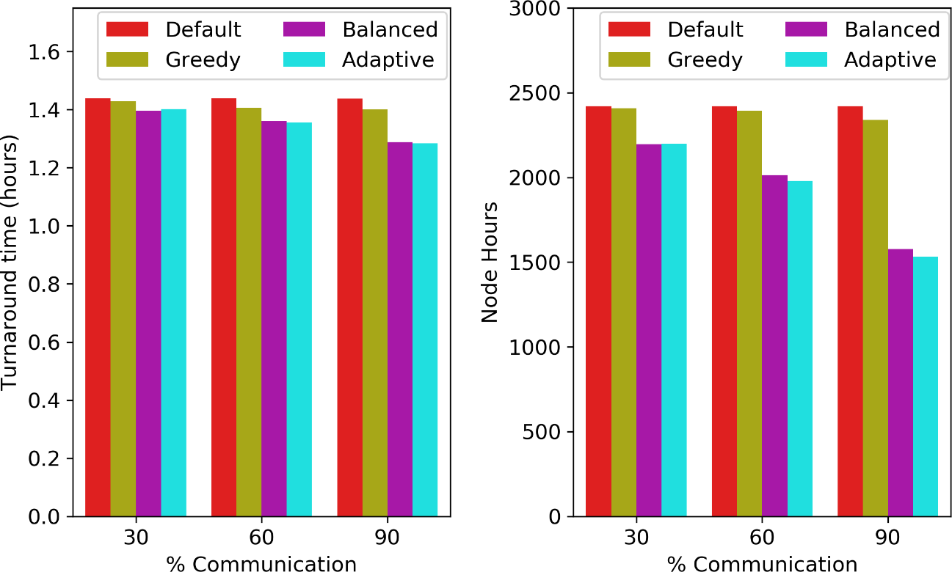
Variation with percentage of communication jobs
ICPP – SRMPDS’20 Communication-aware Job Scheduling using SLURM
For all percentages, the proposed algorithms perform better than default
Gain increases with percentage of communication jobs
Lower job turnaround times and lower node-hours → jobs finish faster improving system throughput
Upto 31% for Theta and 12.5% for Mira
Figure: Comparison of turnaround times (in hours) and node hours for Intrepid for RHVD

Slide 36
Impact on communication cost
ICPP – SRMPDS’20 Communication-aware Job Scheduling using SLURM

Slide 37
Design of Greedy algorithm
Underlying leaf switches are sorted in order of communication ratio
For communication-intensive jobs: switches sorted in increasing order
For compute-intensive jobs: switches sorted in decreasing order
Requested number of nodes allocated from switches in sorted order

Slide 38
Design of Balanced Algorithm
The underlying leaf switches are sorted in order of their free nodes
For communication-intensive jobs: switches sorted in decreasing order
For compute-intensive jobs: switches sorted in increasing order
For compute-intensive jobs:
Requested nodes are allocated from the switches selected in sorted order
There is no constraint of allocating in powers of two

Slide 39
Allocation of communication-intensive jobs
Number of nodes allocated is the largest power of two that can be accommodated on the leaf switch
What if we cannot allocate strictly in powers of two?
In this case, there are still remaining nodes to allocate but all leaf switches have been used
The algorithm traverses the leaf switches again but in reverse sorted order
The remaining free nodes on each leaf switch are allocated
Notes:
This number is deduced by sub-dividing the required nodes to a lower power of two nodes that can be allocated on a leaf switch
Since there are some unallocated free nodes on the leaf switches, we may not be able to satisfy the node requirement of the job
until the node request is satisfied

Slide 40
Communication-aware Job Scheduling using SLURM
Priya Mishra, Tushar Agrawal, Preeti Malakar
Indian Institute of Technology Kanpur

Slide 41
Consider
Leaf Switch | L[1] | L[2] | L[3] | L[4] | L[5] | L[6] | L[7]
Free Nodes | 160 | 150 | 100 | 80 | 70 | 50 | 40
Allocated Nodes | 128 | 128 | 64 | 64 | 32 | 32 | 32
512
256
128
128
256
128
128
64
64
64
64
32
32

Slide 42
512
256
128
128
256
128
128
64
64
64
64
32
32
Leaf Switch
L[1]
L[2]
L[3]
L[4]
L[5]
L[6]
L[7]
Free Nodes
160
150
100
80
70
50
40
Allocated Nodes
128
128
64
64
32
32
32

